Slide 1
Arlington avenue traffic calming
Traffic Bureau
March 07, 2022

Slide 2
Arlington Ave Project Timeline
September 2020: traffic calming request received
January 2021: traffic volume and speed data collected
April 2021: engineering evaluation performed, project accepted into design
July 2021: design phase paused for outreach with emergency services
February 2022: design phase restarted
March 2022: anticipated design complete
May 2022: begin construction

Slide 3
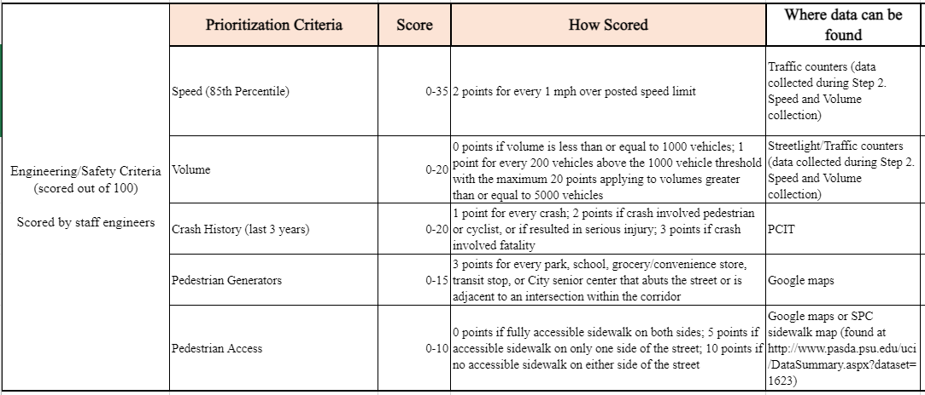
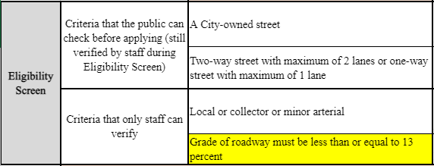
Evolution of Traffic Calming Program

Slide 4
Evolution of Traffic Calming Program
Lessons Learned:
Line striping and signage alone has minimal impact on speeding
Speed humps (and other vertical deflection devices) most effective at reducing 85% speeds above 25 mph
Uses of street extremely important when programming speed humps:
Extra care needed on transit and emergency services routes
Cannot deploy speed humps along entire street

Slide 5
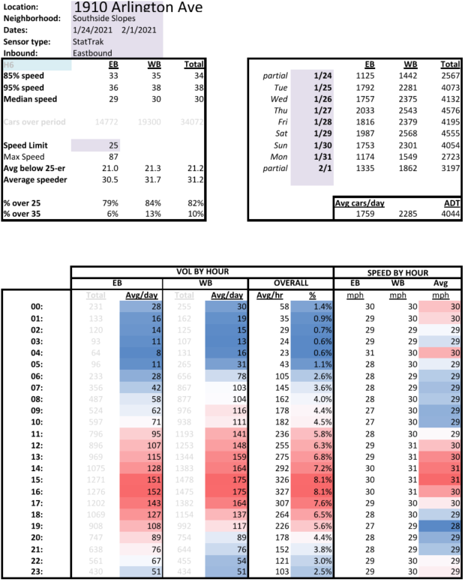
Arlington Ave Traffic Speed and Volume Data
Arlington west of Spring St
2021
Average Daily Traffic: 4,000 vpd
Median Speed: 30 mph
85th Percentile Speed: 34 mph
Percent of Motorists Driving
over the Speed Limit: 82%

Slide 6
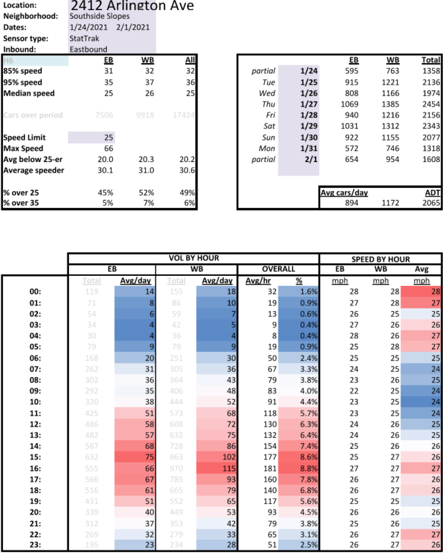
Arlington Ave Traffic Speed and Volume Data
Arlington east of Spring St
2021
Average Daily Traffic: 2,000 vpd
Median Speed: 25 mph
85th Percentile Speed: 32 mph
Percent of Motorists Driving
over the Speed Limit: 49%

Slide 7
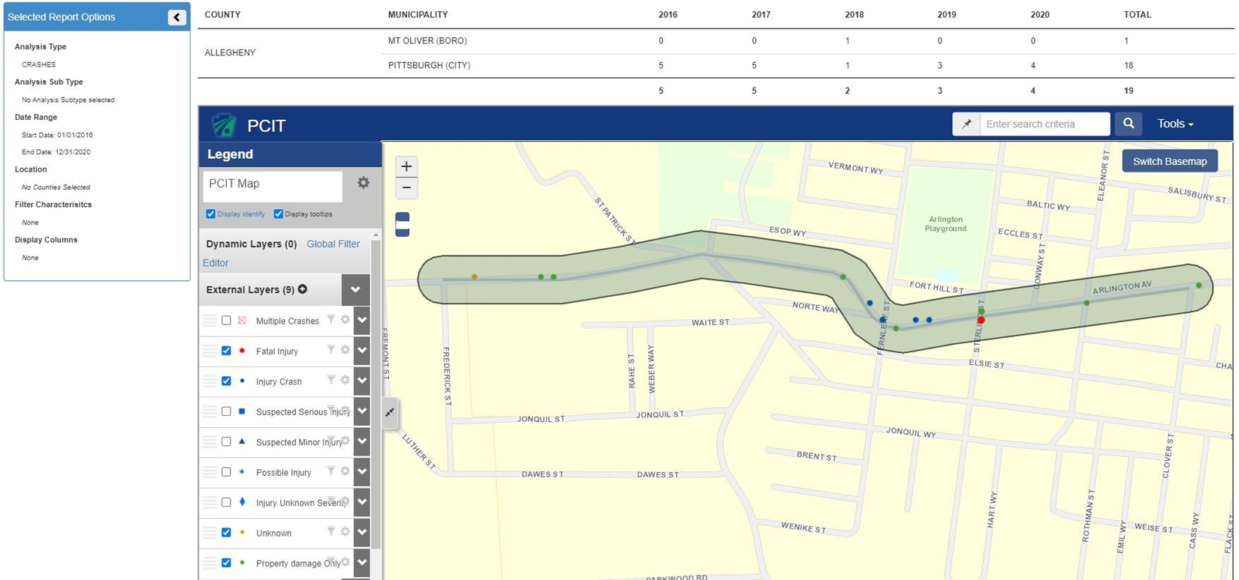
Arlington Ave Crash Data
Date range: 2016-2020
Limits: Frederick Street to Clover Street

Slide 8
Early Action Improvements
Fernleaf All-Way Stop
All-way stop previously approved
Eastbound stop sign was not installed due to grade of street
Numerous community complaints to add sign
Traffic volumes roughly equivalent (meets warrant)
Installed on trial basis

Slide 9
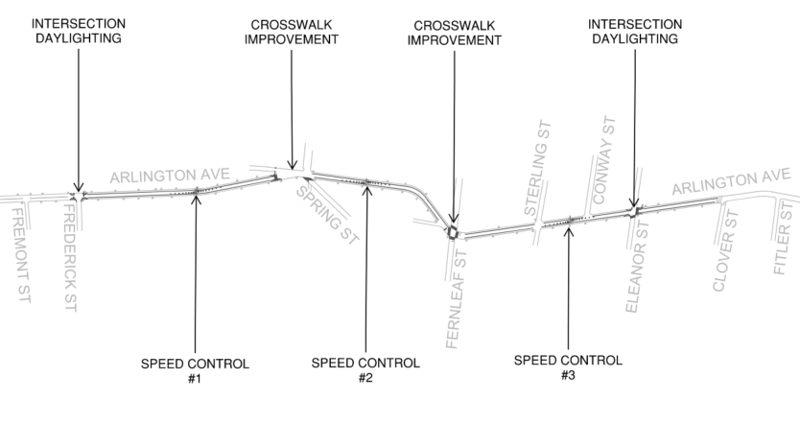
Potential Improvements
Preliminary Traffic Calming Plan
Intersection Daylighting
Improve visibility by restricting parking at corners
Crosswalk Improvement
Upgrade existing crosswalks to hi-viz markings
Centerline Removal
Street too narrow if parking remains
Speed Control
Speed Table or Speed Cushion, to be determined

Slide 10
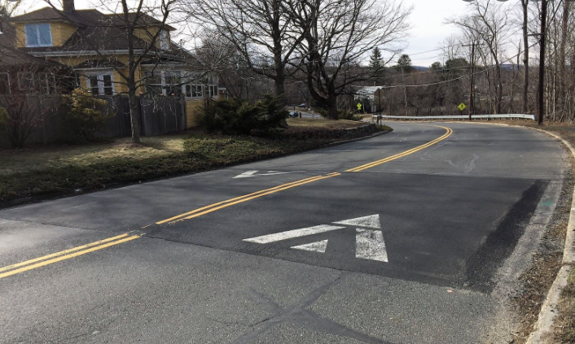
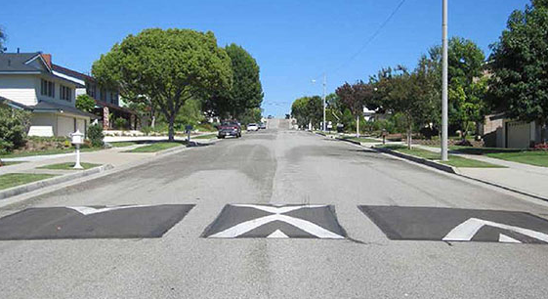
Potential Improvements
Speed Control
Primary emergency service and transit route
Cannot construct speed humps in series along entire length of Arlington
Need for alternate type of speed hump that supports services
Speed Table Speed Cushion

