Slide 1
DOMI
STRIP DISTRICT PROJECTS
Kevin Brown
Principal Planner, DOMI
Kevin.Brown@pittsburghpa.gov

Slide 2


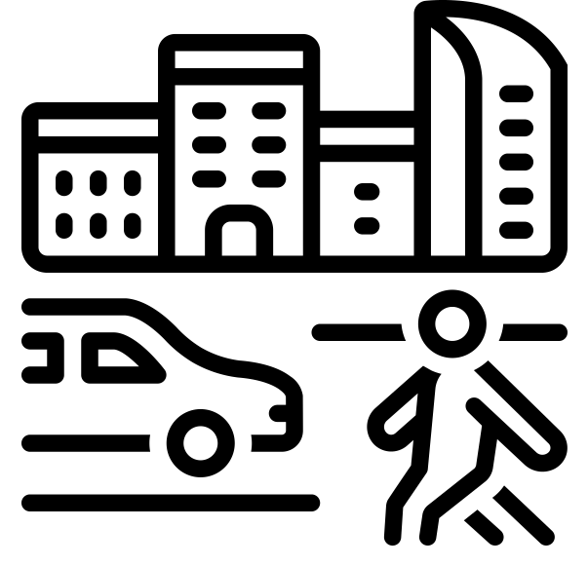

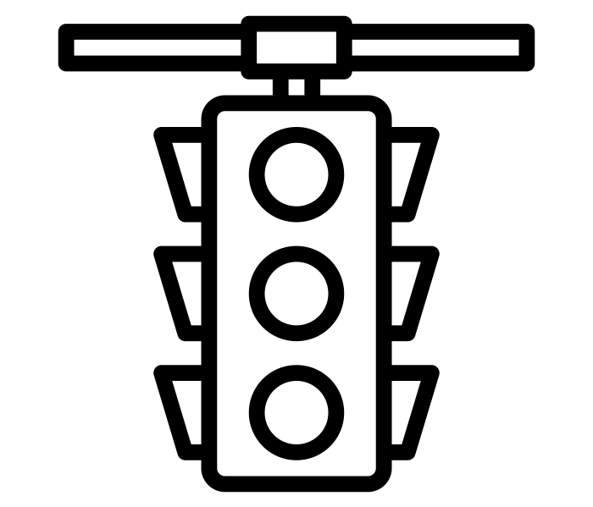
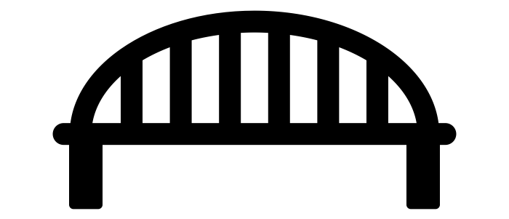

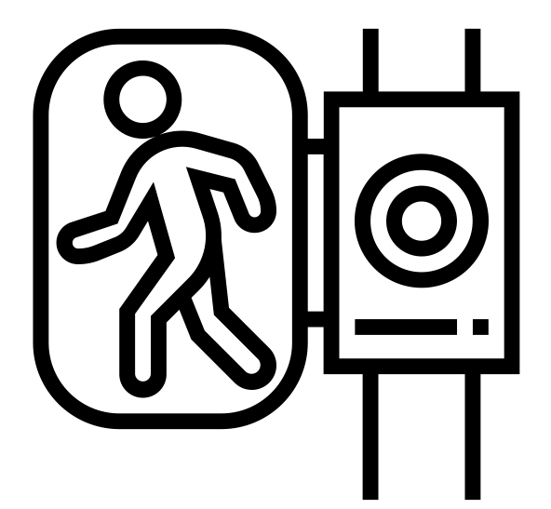

2
Strip District Projects
  Existing Conditions
  Mobility Concerns
  Liberty Ave HSIP (Status: Final Design)
  28th St Bridge (Status: Prelim Engineering)
  Penn Avenue Signals (Status: Contract Negotiation)
  Smallman St Bike Lane (Status: Initial Public Engagement)

Slide 3
4
Existing Conditions
The Strip District
Iconic Pittsburgh Neighborhood
Bustling Retail, Residential, Dining, and Cultural Center
Pedestrian and Vehicular Traffic Generator
Increasing development throughout the district: retail, office, and residential
Flatland connection between Downtown/Cultural District/Northside and neighborhoods to the east (Lawrenceville and Bloomfield).

Slide 4

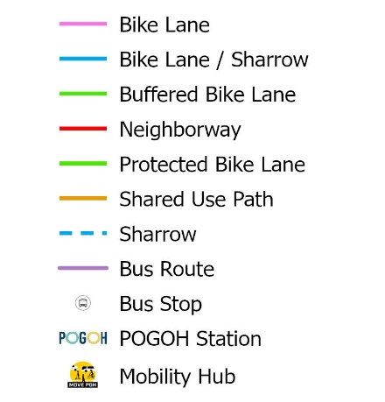
5
Existing Transit and
Bike Facilities
Existing Facilities
Several POGOH stations
Mobility Hub
Multiple Bus Routes
Shared and Dedicated Bike Facilities
Routes that pass through the Strip: 54, 86, 87, 88, 91

Slide 5

6
Road Network
Most streets have two-way traffic
One-way traffic along Penn and numbered streets in the core area
Penn and Liberty each have several signalized intersections in the corridor
Smallman St features two-way traffic that is largely stop sign controlled

Slide 6
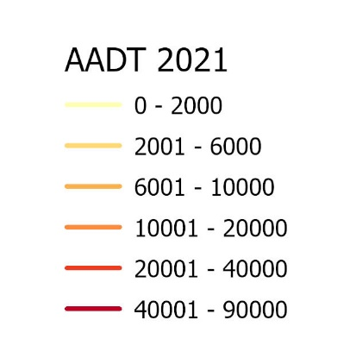
7
Traffic Data
AADT within the Strip
2021 PennDOT
AADT Truck
Smallman St: 6600 4%
Penn Ave: 4000 5%
Liberty Ave: 13,800 5%
Liberty Ave
Two Way Traffic
Four Lanes
Penn Ave
One Way Traffic
Two Travel Lanes
Two Parking Lanes
Smallman St
Two Way Traffic
Two Travel Lanes
Two Parking Lanes

Slide 7
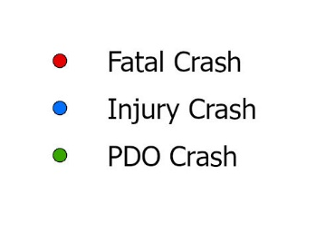
8
Crash Data
Street | Total Crash | Injury Crash | PDO Crash | Fatal Crash | Ped Crash | Bicycle Crash
Smallman St | 30 | 8 | 22 | 0 | 1 | 1
Penn Ave | 115 | 45 | 70 | 0 | 13 | 0
Liberty Ave | 154 | 78 | 76 | 1 | 12 | 2
2018 – 2022
PCIT Data

Slide 8

9
Crash Data
Smallman St: 30 Crashes
Penn Ave: 115 Crashes
Liberty Ave: 154 Crashes
Smallman St: higher traffic volumes than Penn but lower crash counts
Penn Ave and Liberty Ave: More injury crashes
Most drivers are driving over the speed limit.
  25 mph marked speed limit
  30 mph 85th percentile speed
2018 – 2022
PCIT Data

Slide 9
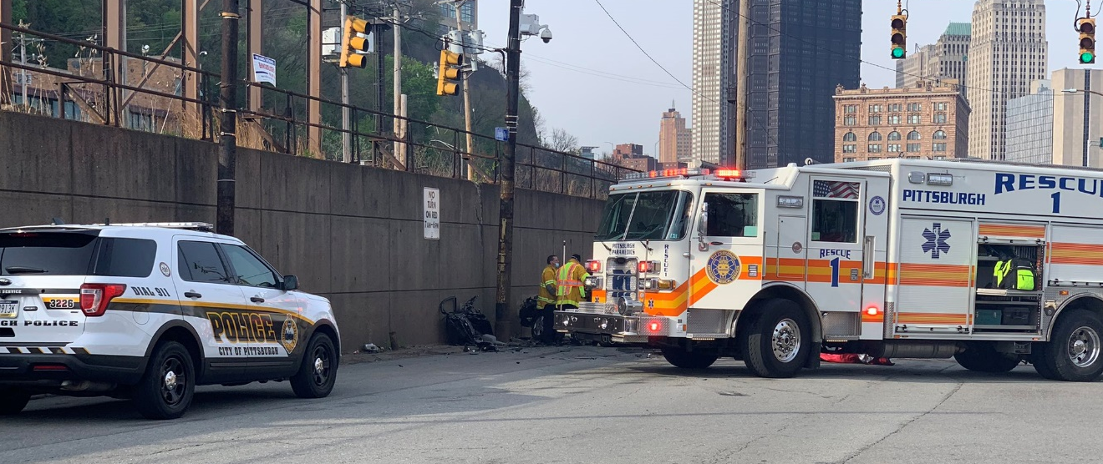
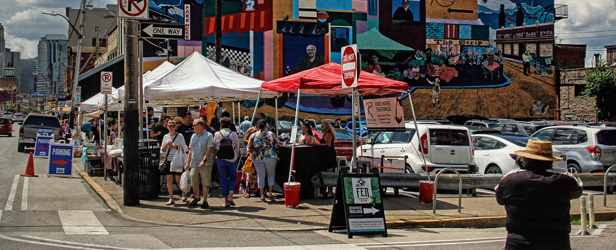
10
Mobility Concerns
EMS Access
Pedestrian Volumes
Main EMS through route is on Liberty Avenue,
Penn Avenue used to access localized incidents
EMS must be able to operate safely
Must be acceptable that EMS responses close Penn Avenue during response
High pedestrian volumes in the Core
At peak times, pedestrian volumes will exceed the sidewalk width and likely spill onto adjacent spaces (parking, bike facilities, street)
Outdoor dining and other pedestrian space uses reduce the flow of pedestrians

Slide 10
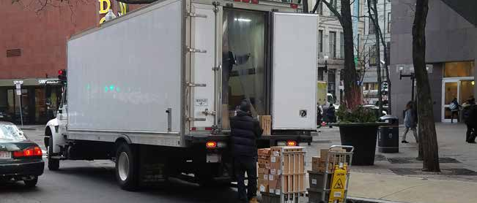
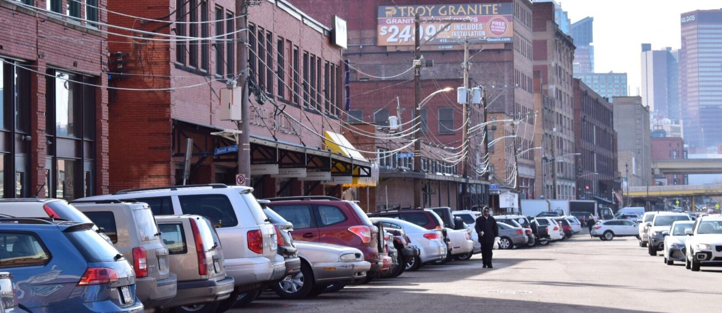
11
Mobility Concerns
Loading
Parking Impacts
Improper loading is a major issue in the Strip
Loading too close to intersections reduces visibility
Loading in travel lanes increases driver frustration and visibility issues for pedestrians
Driving on to the sidewalk to load/unload (Sun Fresh Foods)
On-street parking only a small percentage of available parking within walking distance
Parking in the Strip District is underpriced

Slide 11
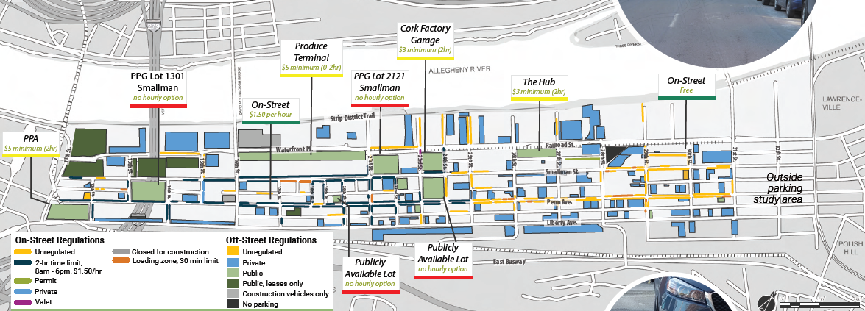
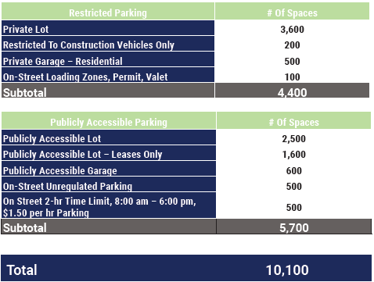
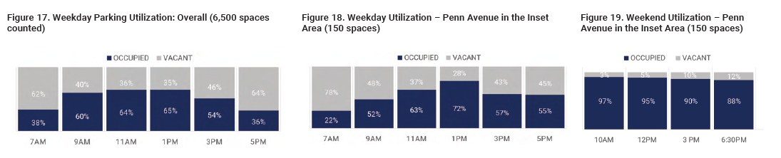
12
Parking
Parking Inventory
2018
  8 Publicly available parking lots/garages within a short walk of the core
  Many private parking lots/garages
  On-street parking is the cheapest option in the area with stretches of unregulated parking around the Strip. (starts on Smallman after 24th St)
  Even at busiest time there are still hundreds of unused parking spaces within the Strip.
  On-street parking is at or over capacity on weekends especially in the core.
Weekend Parking Utilization
Weekday Parking Utilization

Slide 12

Active and Upcoming Projects
  Liberty Ave HSIP (Status: Final Design)
  28th St Bridge (Status: Prelim Engineering)
  Penn Avenue Signals (Status: Contract Negotiation)
  Smallman St Bike Lane (Status: Initial Public Engagement)

Slide 13



15
Liberty Ave Highway Safety Improvement Program (HSIP)
Liberty Ave is identified in the Strip District Mobility Plan as a transit street. It has the most transit stops of all of the streets in the Strip and also the highest traffic. It is a critical corridor for moving automobiles through the Strip District.
DOMI staff are here to answer your questions about this project.
The Liberty Ave HSIP aims to improve safety for pedestrians and vehicles. The programs includes upgrades to:
Patricia Kerns, P.E.
Project Manager
Traffic Signal Upgrades
Traffic Safety Improvements
Pedestrian Safety Improvements
Transit Improvements
Check Out the Engage Page

Slide 14



15
Liberty Ave Highway Safety Improvement Program (HSIP)
Pedestrian Safety Improvements
  Intersection "bump-outs"
  Pedestrian Refuge Islands
  Leading Pedestrian Intervals
Traffic Signal Upgrades
  Full replacement at 16th, 21st, 25th, 26th, 28th, and 31st
  New signal at 27th
  Rectangular Rapid Flashing Beacon signal conversion at 17th
  Timing updates at Herron, 16th and Penn, 31st and Penn
Timeline
Traffic Impact Study
Transit Improvements
  Widened sidewalks at bus stops
  Bus Stop Upgrades
  Bus Stop Consolidation
Line, Grade, and Typical Section Submission
Design Field View Submission
NOW
Final Design Submission
Traffic Safety Improvements
  High-visibility signal heads
  Improved lane width
  Reduced "conflicts" from road diet
Construction Bid Opening
Construction Notice to Proceed

Slide 15

15
28th Street Bridge Rehabilitation Project
The 28th Street Bridge carries traffic over Sassafras Way, Norfolk Southern RR, and PRT East Busway. The structure is nearly 100 years old and has the main span truss is considered a historic example of a riveted Parker Through Truss bridge. Traffic over the bridge has been restricted in recent years to ensure safety of bridge users.
DOMI staff are here to answer your questions about this project.
The 28th Street Bridge Rehabilitation Project aims to repair and extend the life of this historic truss while modernizing the entire bridge.
Erin Feichtner, P.E.
Project Manager
Check Out the Engage Page

Slide 16
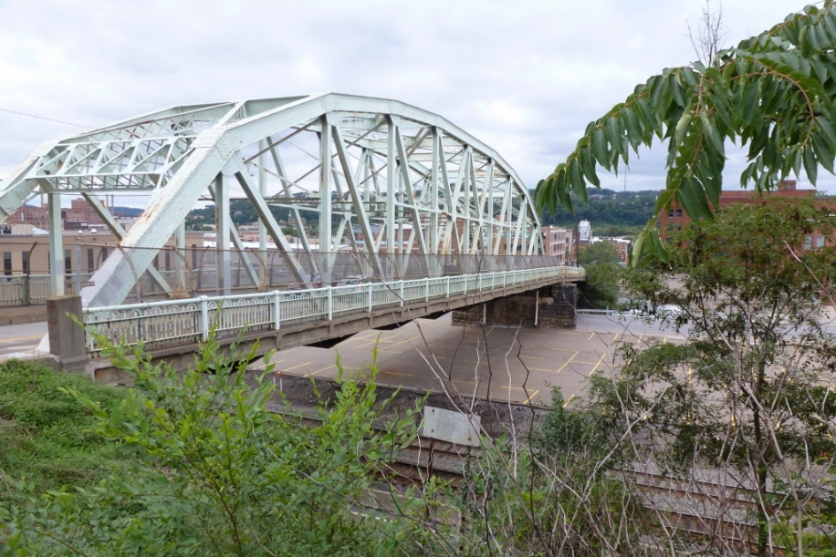
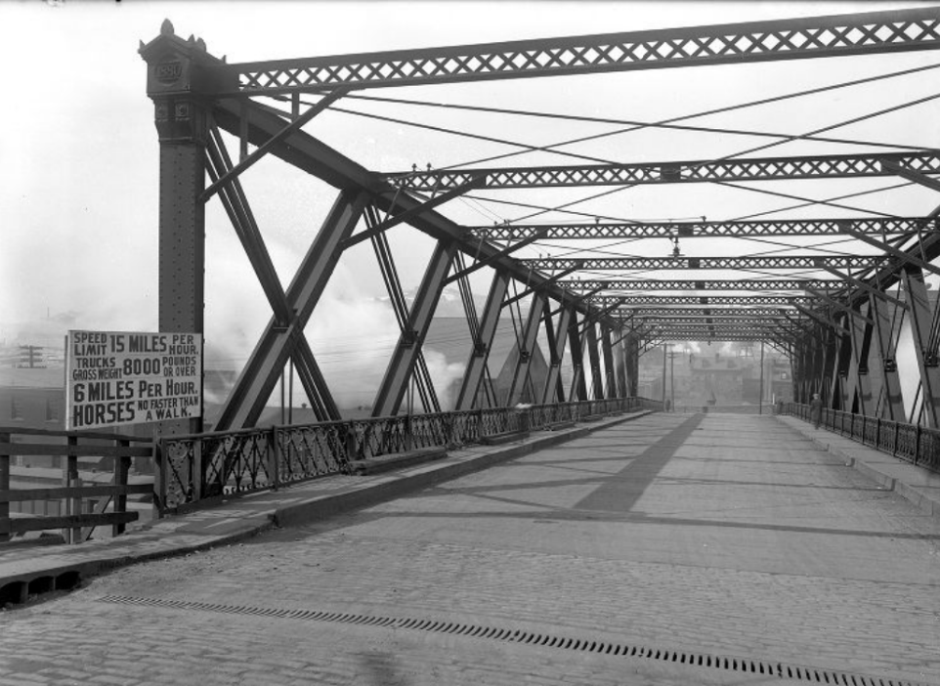
15
28th Street Bridge Rehabilitation Project
Timeline
Preliminary Engineering
Site Survey
Inspection
Traffic Analysis
“Purpose & Need”
Historic Bridge Rehab Analysis
Line and Grade
28th Street Bridge
NOW
Preliminary Engineering
Permitting
Design
Public Meeting
Utility Coordination
Cross Sections
Design Field View Report
Final Design
28th Street Bridge Circa 1924
Construction

Slide 17

15
Penn Avenue Signals
Penn Ave is identified in the Pedestrian Safety Action Plan as a “Network-Need Corridor”. The popular shops and restaurants in the core and beyond attract high pedestrian volumes. There are also transit stops every block from 26th to 32nd.
DOMI staff are here to answer your questions about this project.
The Penn Avenue Signal Replacement project aims to improve safety, efficiency, and reliability for all users of Penn Ave in the Strip District. This project includes upgrades to:
    Vehicular Signal Heads
    Pedestrian Signal Heads (with countdown)
    Accessible Pedestrian Signal Devices
    Inbound On-Street Bike Facilities (to pair with outbound on-street bike facility on Smallman Street)
Mike Maloch, P.E., PTOE
Municipal Traffic Engineer

Slide 18
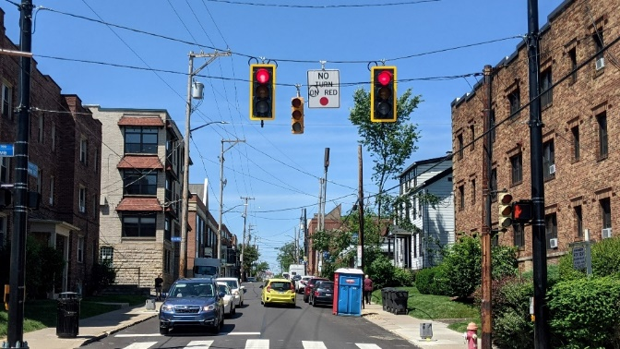
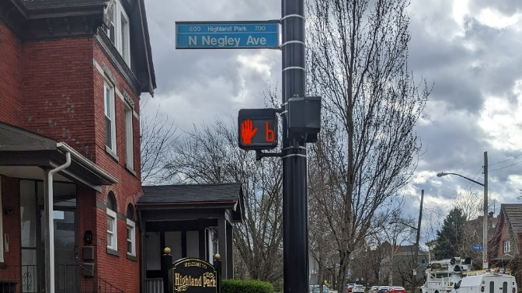
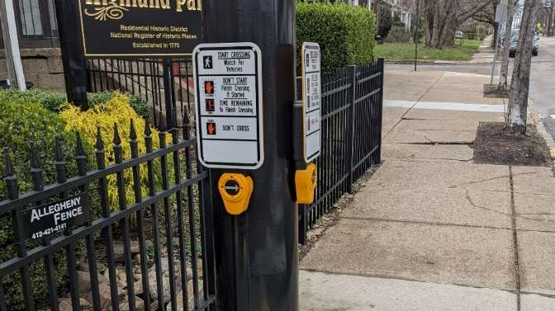
15
Penn Avenue Signals
    Vehicular Signal Heads
      New vehicular signal heads with back plates
Timeline
Scoping Field View
    Pedestrian Signal Heads
      New pedestrian signal heads with countdown
Consultant Advertisement and Selection
NOW
Scoping and Contract Negotiation
    Accessible Pedestrian Signal Devices
      New accessible pedestrian signal devices that communicate information about WALK and DON’T WALK intervals.
Start of Design: Prelim Engineering Phase
Start of Final Design Phase
Construction

Slide 19

16
Smallman Street Bike Lane
Smallman Street is identified in the Strip District Mobility Plan as a good location for dedicated/protected bike facilities. Smallman Street has lower crash volumes than both Penn and Liberty Aves and is already used by cyclists as a connection through the Strip District.
DOMI staff are here to answer your questions about this project.
The Smallman Street Bike Connection project aims to provide a dedicated and safe bike connection through the strip. This project includes:
    Dedicated Bike Facilities Outbound on Smallman St to pair with the inbound On-Street Bike Facilities on Penn Ave.
    Wayfinding To/From Existing and Proposed Facilities
    Safe Connections to Existing and Proposed Facilities
Kevin Brown
Principal Planner
Notes:
This route and designs are an evolution of the route laid out originally in the 2070 vision and then refined in the Strip District Mobility plan. These designs do not preclude any future network changes that we may want to make toward a final vision for the strip especially through the core.

Slide 20
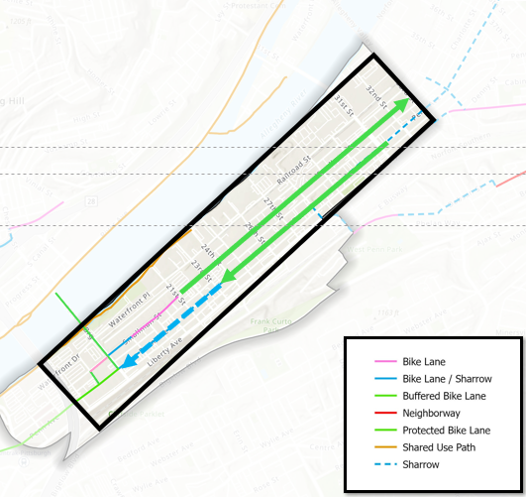
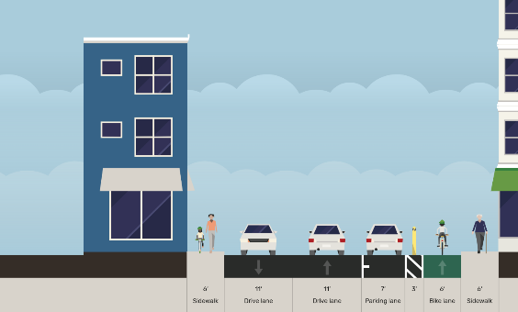
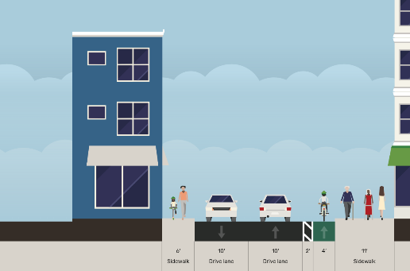
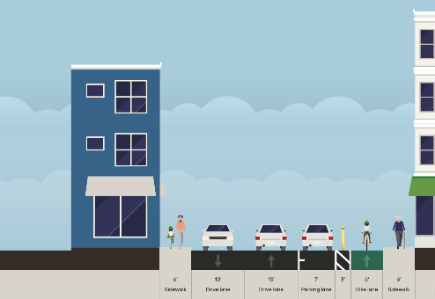
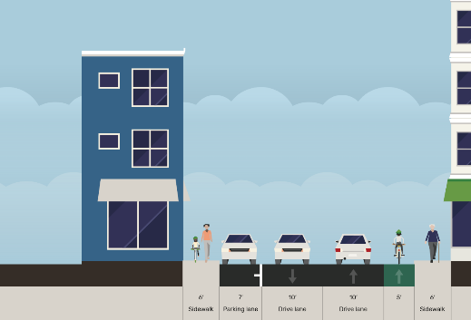
16
Smallman Street Bike Lane
Timeline
A dedicated bike lane will extend from 21st St to 31st St. The type of facility may vary depending on block-by-block constraints.
Scoping and Initial Analysis
Connection to Existing Network
NOW
Initial Public Engagement
Parking Protected Bike Lane
Buffered Bike Lane
Consultant Selection and Onboarding
Design Phase
Construction
Protected Bike Lane
On-Street Bike Lane
Facility Types
Notes:
This route and designs are an evolution of the route laid out originally in the 2070 vision and then refined in the Strip District Mobility plan. These designs do not preclude any future network changes that we may want to make toward a final vision for the strip especially through the core.

Slide 21

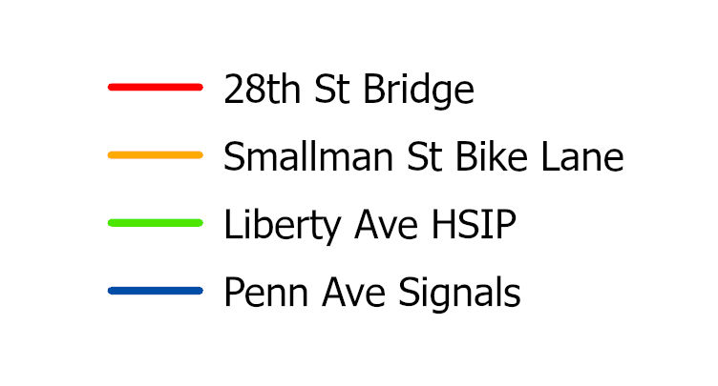
Fitting It Together
While these projects are all at different stages they work together to transform (and improve) the transportation network within the Strip District.

Slide 22

Come Chat With Us!
28

