Slide 1
Braddock Forbes Signal Replacement Project
Community Meeting
September 18th, 2023

Slide 2
Agenda
Introductions
Meeting Overview
Project Purpose
Background
Recommended Alternative
Cost & Timeline
Summary
Questions

Slide 3
Introductions
Michael Maloch, PE ,PTOE Municipal Traffic Engineer, Dept of Mobility & Infrastructure
Leila Bouabdellaoui Project Manager, Dept of Mobility & Infrastructure
Geoff Leonard Planner, Dept of Mobility & Infrastructure
Jan Raether Infrastructure Engagement Specialist, Mayor's Office of Neighborhood Services
Ashley Bryant Community Liaison, Mayor's Office of Neighborhood Services

Slide 4
Meeting Overview
Create a space where all perspectives are welcomed; agree to disagree in peace.
Save questions for end of presentation
Livestream viewers submit questions through ZOOM
All speaker use the microphone for the benefit of our at home viewers
Respect each other's time and speak one at a time
Agree to shared ownership of these norms

Slide 5
Project Purpose
The purpose of the traffic signal improvement at Forbes Ave and Braddock Ave is to improve safety, update traffic signal infrastructure, and reconsider the flow of traffic for people walking, crossing, driving, biking, and taking public transit through this intersection.

Slide 6
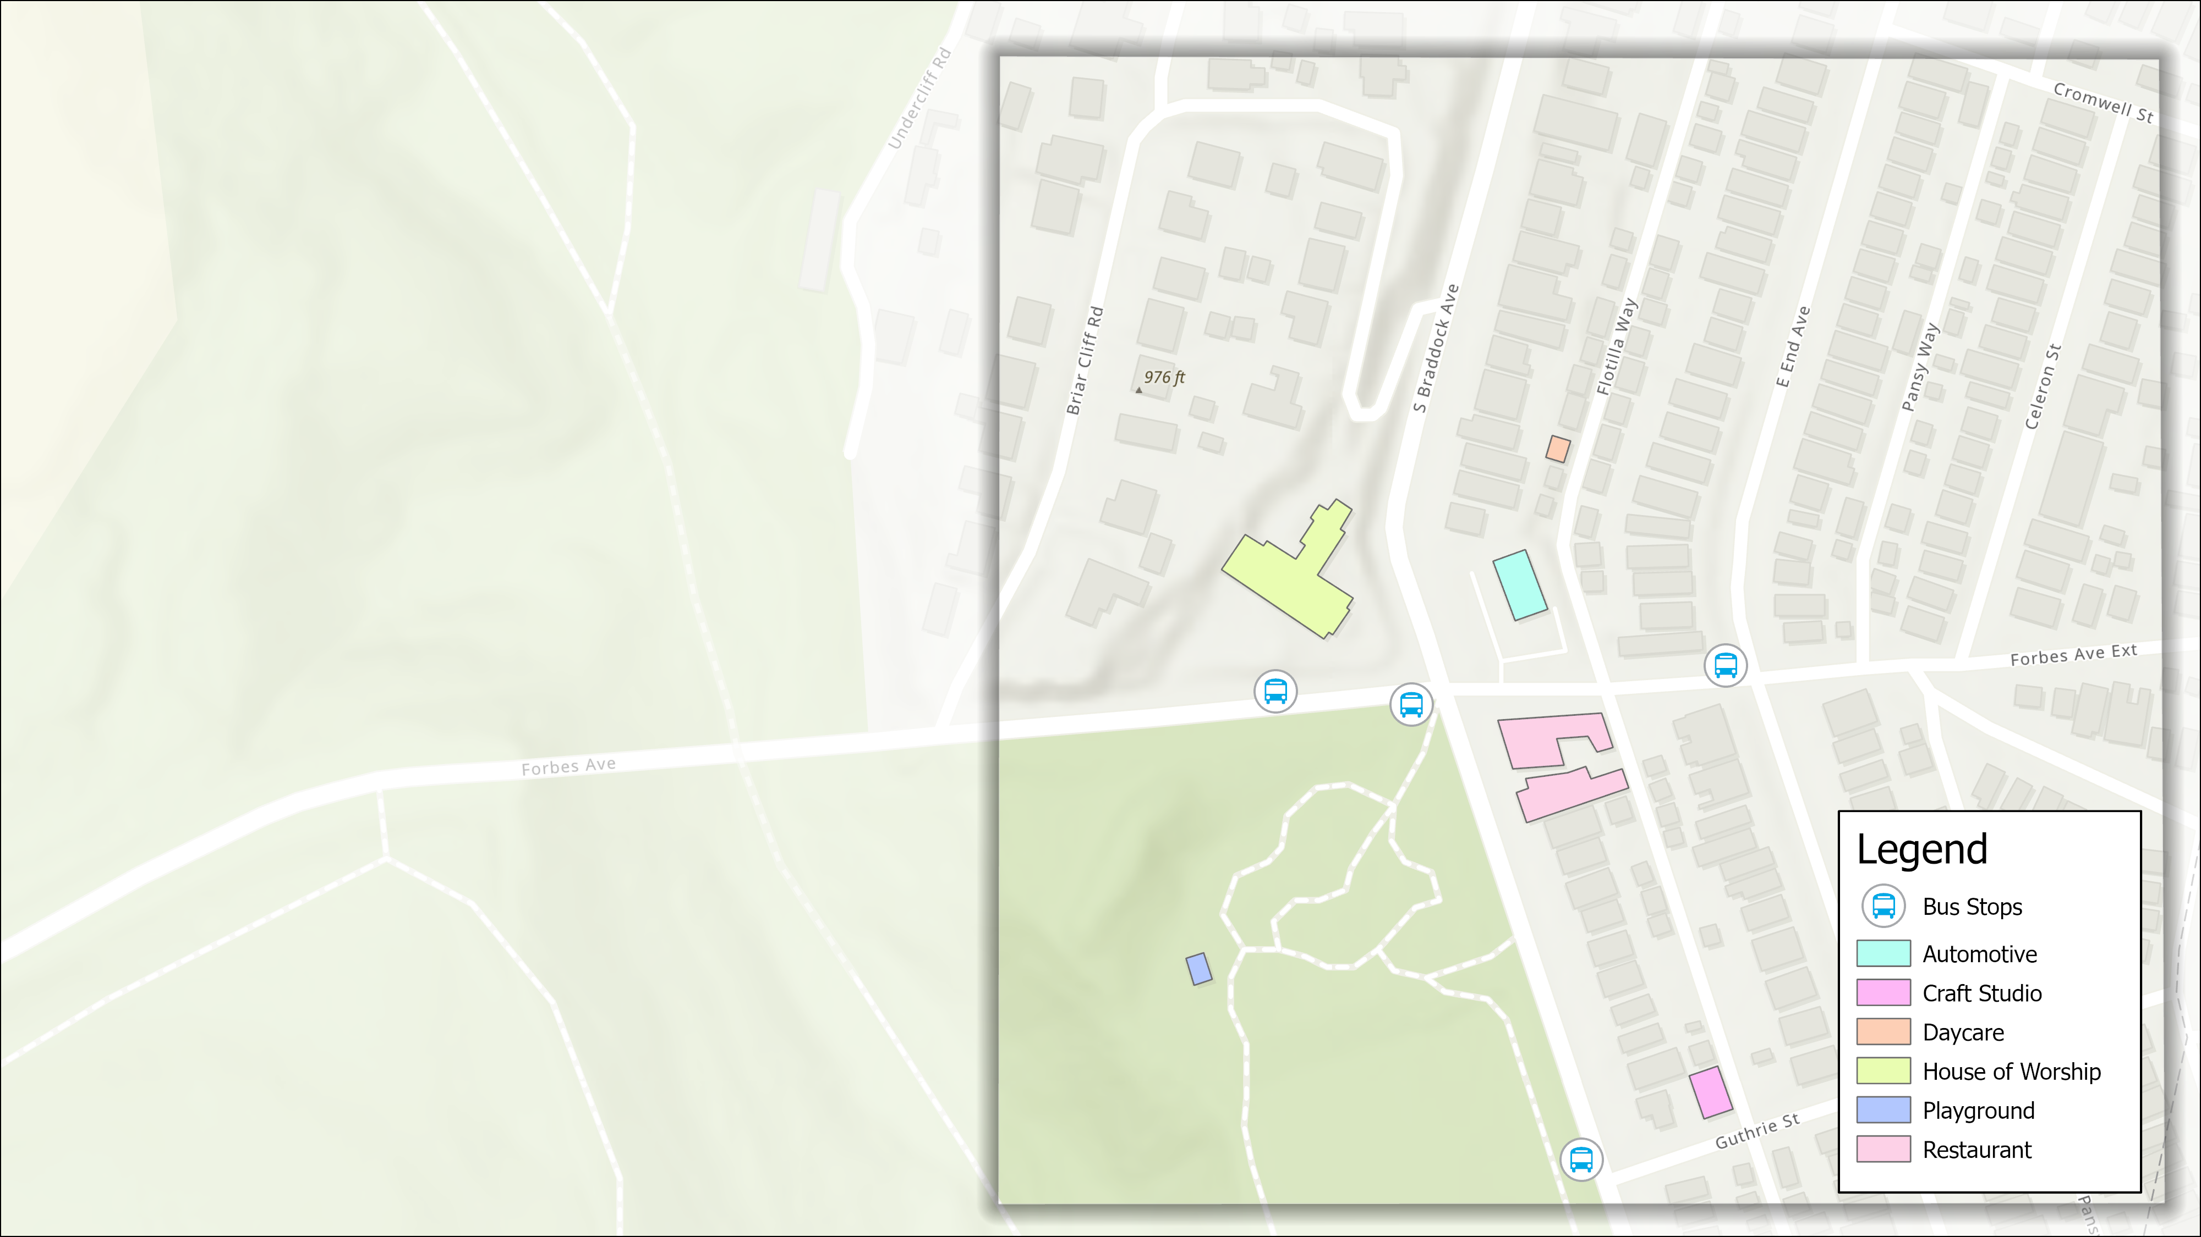
Project Location
This project is:
At the intersection of Forbes Ave & Braddock Ave.
On the border of Point Breeze and Regent Square.
On the border of council district 5 (Warwick) and 9 (Burgess).
Church
Business District
Frick Park

Slide 7
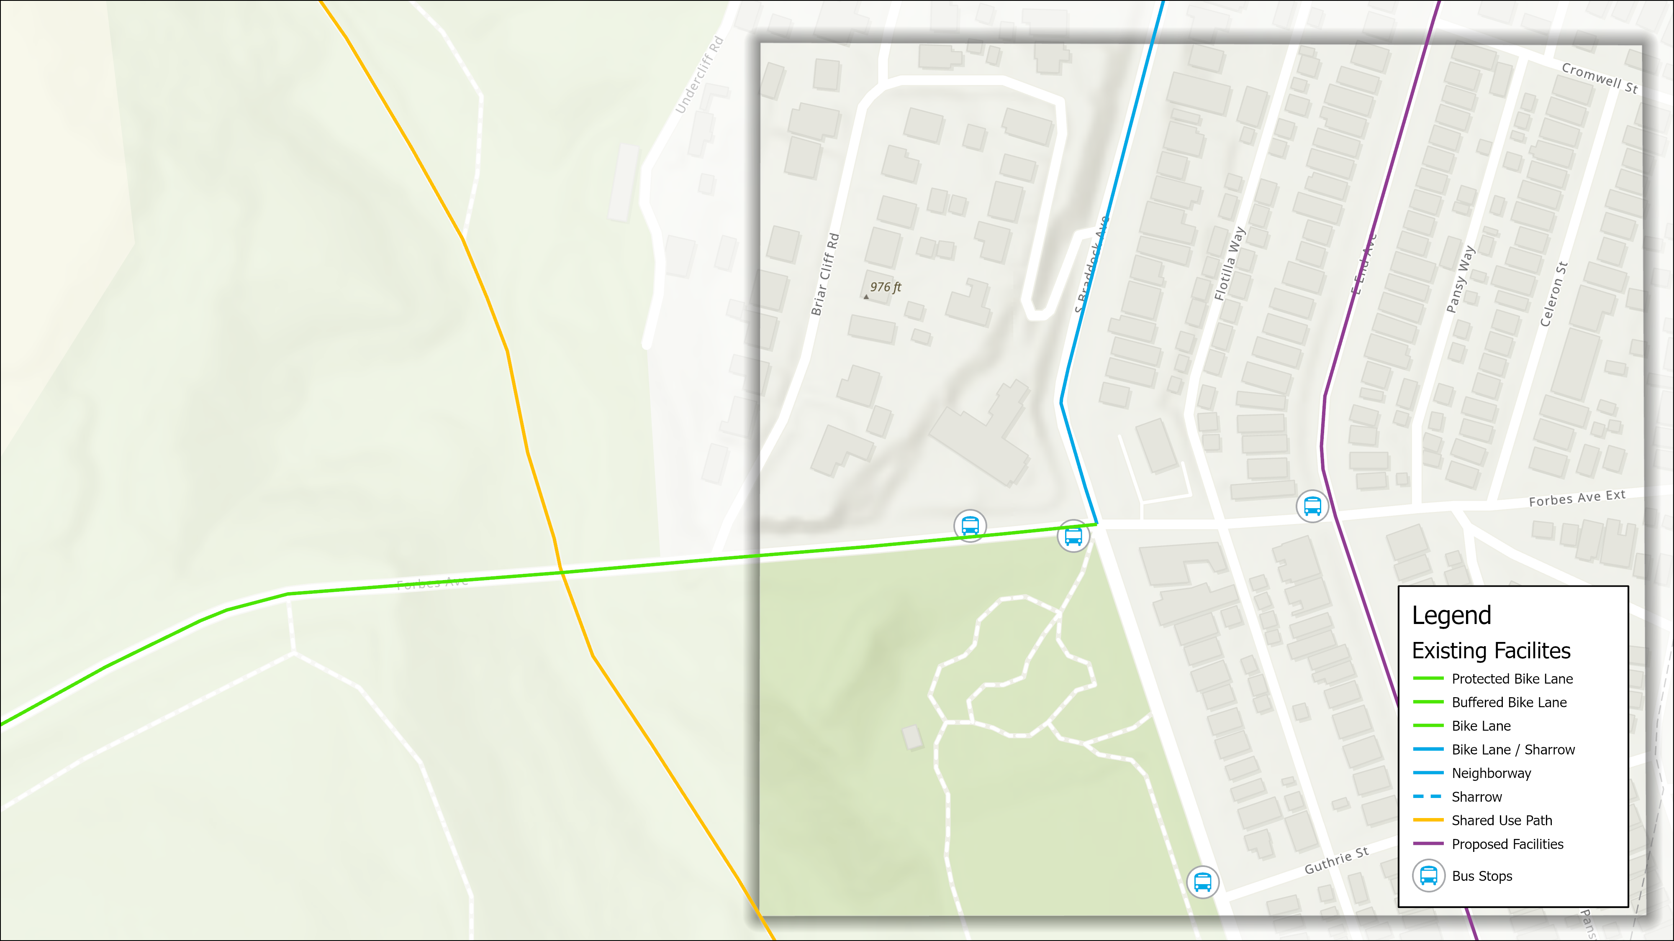
Bike Facilities
Forbes Ave protected bike lane.
Southbound bike lane on Braddock Ave until Forbes Ave.
Bike Lanes
Protected Bike Lanes
Bike Racks

Slide 8
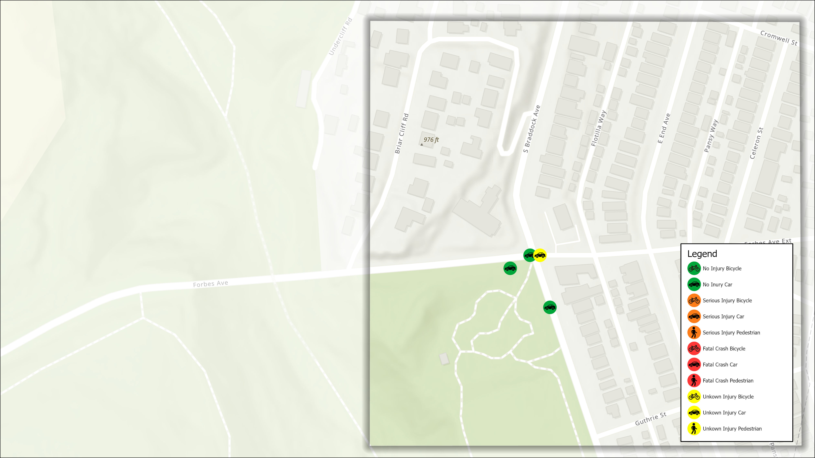
Crash History
Long-term need for updated infrastructure and improved safety and accessibility
Intersection crash history indicates 14 crashes (2017-2021)
4 hitting a fixed object
3 rear-end
3 sideswipe collisions
2 angle
2 other
No reported pedestrian incidents.

Slide 9
Background & Schedule
Funding for this project is an 80/20 split between PennDOT grant and City funds.
Total project cost = $589,219
December 2021
PennDOT Green Light-Go Application submitted
Summer 2022
Grant awarded Summer 2022
September 18, 2023
Public Meeting
January 2024
Final Design posted on EngagePGH
Summer 2024
Construction Begins
Winter 2024
Construction Complete

Slide 10
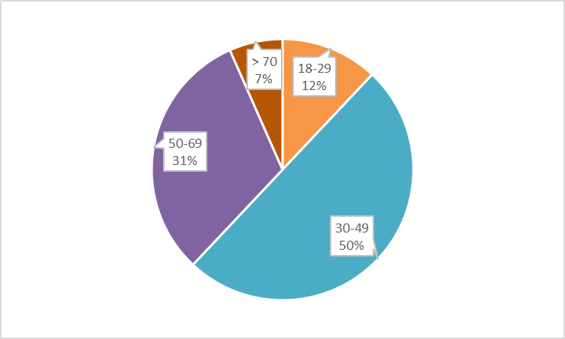
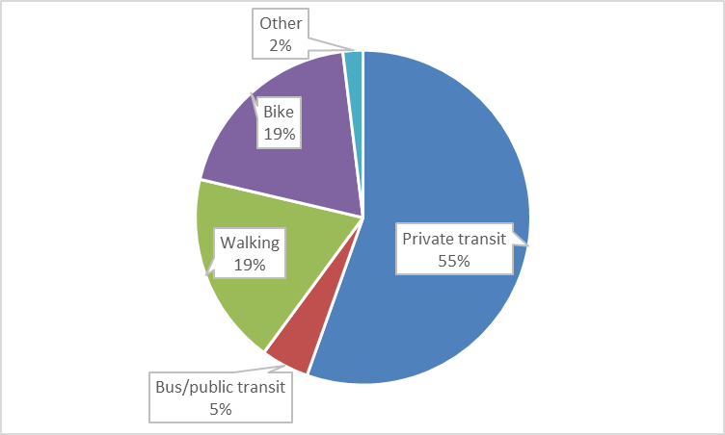
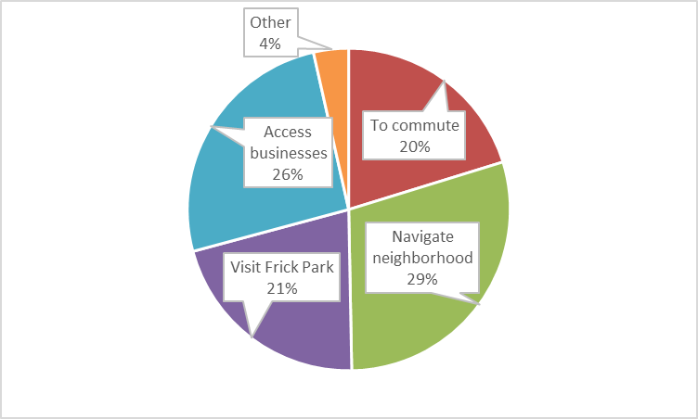
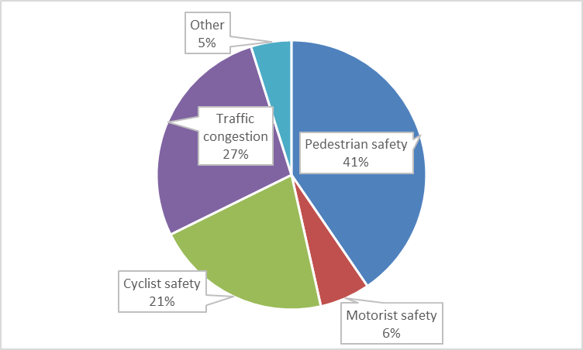
Survey Results
AGE
MODE OF TRAVEL
INTERSECTION USE
BIGGEST CONCERNS

Slide 11
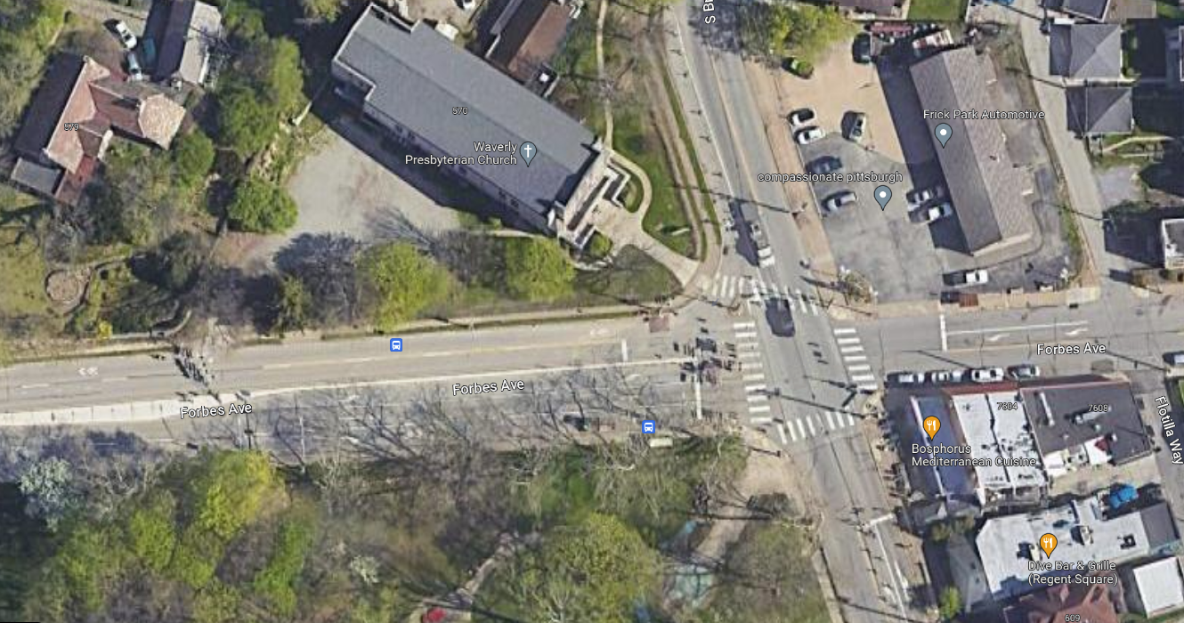
Existing Conditions

Slide 12
Design Treatments/Updates
Improved intersection layout
Intersection bumpouts to reduce crossing distances
Detection for all approaches to improve the traffic flow of vehicles, bicycles, and pedestrians

Slide 13
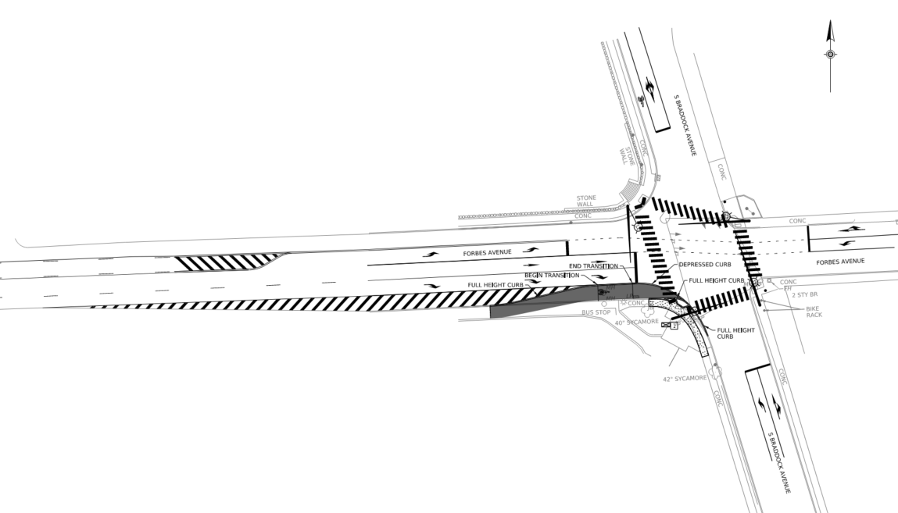
Proposed Design Sketch
Change in lane configuration on Braddock Ave SB approach
No left turn
Removal of island near NW corner
Lane transition & bike bumpout on Forbes Ave EB approach

Slide 14
Average Travel Delay
 | Direction | No-Build | Proposed* | Difference
AM Peak Hour | Eastbound Left | 1.5 | 0.5 to 1.0 | -1.0 to -0.5
 | Eastbound Right | 0.5 | 0.25 to 0.5 | -0.25 to +0.0
 | Eastbound | 0.7 | 0.2 to 0.6 | -0.5 to -0.1
 | Westbound | 1.7 | 0.7 to 1.3 | -1.0 to -0.4
 | Northbound Left | 1.4 | 0.4 to 2.0 | -1.0 to +0.6
 | Northbound | 1.5 | 0.5 to 1.5 | -1.0 to +0.0
 | Southbound | 1.0 | 1.5 to 3.3 | +0.5 to +2.3
 | Intersection | 1.3 | 0.8 to 1.8 | -0.5 to +0.5
PM Peak Hour | Eastbound Left | 0.8 | 0.5 to 0.8 | -0.3 to +0.0
 | Eastbound Right | 1.7 | 0.7 to 1.2 | -1.0 to -0.5
 | Eastbound | 1.5 | 0.5 to 1.0 | -1.0 to -0.5
 | Westbound | 0.75 | 0.5 to 0.5 | -0.25
 | Northbound Left | 0.5 | 0.25 to 0.4 | -0.25 to -0.1
 | Northbound | 0.75 | 0.25 to 0.5 | -0.5 to -0.25
 | Southbound | 1.0 | 0.5 to 1.25 | -0.5 to +0.25
 | Intersection | 1.0 | 0.5 to 1.0 | -0.5 to +0.0
(Delay shown in minutes)
 | Direction | No-Build | Proposed* | Difference
MD Peak Hour | Eastbound Left | 0.75 | 0.5 to 0.6 | -0.25 to -0.15
 | Eastbound Right | 0.75 | 0.4 to 0.5 | -0.35 to -0.25
 | Eastbound | 0.75 | 0.4 to 0.5 | -0.35 to -0.25
 | Westbound | 0.8 | 0.5 to 0.8 | -0.3 to +0.0
 | Northbound Left | 0.5 | 0.2 to 0.2 | -0.3
 | Northbound | 0.75 | 0.25 to 0.5 | -0.5 to -0.25
 | Southbound | 0.75 | 0.3 to 1.0 | -0.45 to +0.25
 | Intersection | 0.75 | 0.3 to 0.75 | -0.45 to +0.0
*Proposed alternative assumes pushbutton is pressed 0 to 75% of cycles. Travel delay increases with pushbutton use. Actual delay will be somewhere in between these values.

Slide 15
Summary
Upgrade traffic signal infrastructure
Improve safety and traffic flow at the intersection
Revised intersection layout
Bumpouts
Detection

Slide 16
Follow this project:
Forbes Ave and Braddock Ave Traffic Signal Replacement | Traffic Signal Projects | Engage Pittsburgh (pittsburghpa.gov)
tinyurl.com/49wdcvh7
Reach out to us:
Neighbor@pittsburghpa.gov

Slide 17
Question & Answer

